Slide 1
2011 Competency Model
US Operations

Slide 2
Objectives
Review how Competencies fit into our 2011 Operations Priorities.
Provide context for the development of the Operations Competency model.
Improve understanding of Competencies and how they relate to Skills and Behaviors.
Discuss and agree on next steps.

Slide 3
U.S. Operations Business Goals
Maintain a deep understanding of our clients and their customers
Provide services that are aligned with the priorities of our clients:
  Business Goals
  Strategic Objectives
  Market Differentiators
Develop loyalty and advocacy for U.S. Operations:
  Demonstrate excellence in our core service areas
  Enable our desired client experience
  Proactively evolve in alignment with our clients
Achieve our assigned expense targets through prioritizing work with our clients and continuously identifying efficiencies
Maximize operating income by becoming a valued
and efficient enabler of the success of our clients

Slide 4

U.S. Operations Strategic Objectives
Clearly Define Service Level Agreements
Tool Set
Master Core Competencies
Deliver on Evolution Initiatives
Execution Excellence
Client
Service
People
Management
Product
Launch
Excellence
Flexibility of
Operations
Functions
CFA / CRM
Evolution
Skill Set
Prioritize Initiatives
Define & Align our Core Service Areas
Maintain a Deep Understanding of our Clients
Mind set
* Note: Master data will enable all evolution initiatives and is a prerequisite for success

Slide 5
Competencies, Skills, and Behaviors Defined
A COMPETENCY is a broad category of associated skills, behaviors, or abilities that combine to describe what is required for successful performance in a given organization or job area.
  Excellent performers demonstrate these behaviors much more consistently than average or poor performers.
Each competency is comprised of a subset of SKILLS that provide specific capabilities that demonstrate command of the competency.
Skills are measured by BEHAVIORS, which are actionable descriptions that are easily understood, communicated, and observed.

Slide 6



Description – Execution Excellence
Advisory Services
Project Leadership
Process Leadership
Define Client’s
Business Need
Project Vision
Process Vision
Execution Excellence
Build & Share
Service Plan
(w/Milestones/Timing)
Build & Share Plan
(w/Milestones/Timing)
Map & Validate
Process
Client Service
Review with Client
Assign Roles
Assign Ownership for
each process step
Complete Agreed
Upon Work
Highlight Critical
Dependencies
Highlight Critical
Dependencies
People Management
Package Work
for Client
Monitor Plan
& Problem Solve
Monitor Process
& Problem Solve
Deliver Work
to the Client
Manage
Risk
Manage
Risk
Verify Resolution
of Client Need
Complete & Sustain
the Project
Execute Process

Slide 7

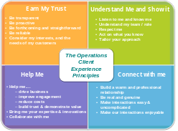


Descriptions – Client Service
Execution Excellence
Enable our
Desired Client
Experience
Help Them
Client Service
Earn Trust
People Management
Understand Them
… and Show It
Connect with
Them

Slide 8
The Value of Identifying & Defining Competencies
The value for each team member:
  Clarifies standards and expectations.
  Aligns individuals, teams, and managers to our priorities / strategies.
  Creates empowerment, accountability, and alignment of coach, team member, and employer on performance development.
  Provides an equitable and focused differentiation / appraisal framework for Operations Leadership
    It is a “common language” for leadership to use in addition to other criteria such as Results, Business Impact / Complexity, and Merck’s Leadership Behaviors.

Slide 9
Why is Mastery of Core Competencies Important?
“The Critical Assumption”
To maintain loyalty and advocacy long-term, U.S. Operations services must be provided at a higher quality and/or lower cost than alternative options.
We must have a process for continuous improvement!
We must leverage our Critical Advantage – A deep understanding our Internal Clients.

Slide 10
2011 U.S. Operations Competencies

Slide 11
Execution Excellence: Advisory Services
Skill | Needs Development | Fully Performing | Outstanding
Define Client Business Need | Inconsistently demonstrate the behaviors defined in the Fully Performing area. Specific behaviors that indicate Needs Development in Advisory Services include: Regularly asks for input on how to do work for ongoing activities Does not actively engage with the client to fully understand business priorities and client needs. Does not develop a clearly framed out project plan, with realistic goals, timelines, etc. Does not undestand/use most appropriate tools, techniques and reports to deliver high quality work/output. Communications with stakeholders and clients do not incorporate client needs, key inputs and decisions required Lacks ability to translate technical information into non-technical output consistent with client needs/understanding. | Engages with business stakeholders through direct dialogue – Acutely understands the business question and confirms the business need(s) with client Understands the key drivers of the client need Understands the business importance, feasibility & urgency to enable prioritization | Proactively and consistently demonstrates the behaviors outlined in Fully Performing area that : Have considerable organizational breadth and aligned to customer needs and priorities Specific behaviors that indicate Outstanding in Advisory Services include: Self-directed and proactively manages the people and roles required to execute the work/project Has sufficient experience expertise to coach and mentor others; serve as a subject matter expert for peers/clients Incorporates appropriate approaches and discipline into their everyday responsibilities Recognized as an advanced Subject Matter Expert (SME) and has developed trust with the client Demonstrates exceptional knowledge of the client, data, tools, resources, decisions points and critical path activities/steps Continuously identifies and implements improvements to process
Build Plan |  | Determines the most efficient and/or effective approaches to addressing the client need Clearly defines and documents the plan to meet client needs (proportional to the size of the project) As appropriate, plan key milestones, due dates, risks, assumptions and any interdependencies. Sets realistic goals and timelines and consistently incorporate SMART goals
Share Plan with Client |  | Proactively shares plan with client and gains agreement around key elements, including milestones, due dates, risks, assumptions and any interdependencies. Gains agreement from the client as to how the analytics/tools/recommendations will be used to benefit the business
Complete Work |  | Uses most appropriate tools, techniques and data sources to address the client need (internal/external resources) Proactively keeps client informed of work progress and any significant changes that occur to the plan Completes high quality, reliable work on time and within budget
Package Work |  | Package technical information in a non-technical fashion commensurate with the client’s understanding of the data/information Translates and integrates key analytical insights into actionable recommendations Uses appropriate application (email, PowerPoint, Word, verbal) for packaging the results Provides necessary documentation for key findings and recommendations
Deliver Results & Verify Resolution |  | Present findings and recommendations to the client in a clear and confident manner Promptly responds to client questions or concerns Performs appropriate follow-up with the client to ensure the solution met the business need Verifies that solutions meet the client business need from the timing, quality and cost stand point Communicate findings to other key stakeholders.
All employees are required to have knowledge, understanding and demonstrate Merck Leadership behaviors.
All employees will be consistently evaluated on their active compliance with all relevant company policies.

Slide 12
Client Services
Skill | Needs Development | Fully Performing | Outstanding
Connect with the Client | Inconsistently demonstrates the behaviors/skills defined in the Fully Performing area Specific behaviors that indicate Needs Development in the Client Service competencies include: Does not consistently demonstrate the ability to develop strong working relationships with clients Does not consistently demonstrate the ability to anticipate client needs or proactively recommend solutions Behavior and actions demonstrate a lack of respect for our clients Does not bring adequate expertise a/o innovative solutions to the client on a consistent basis | Effectively builds a strong working relationships with the client Spends time with client and is accessible Makes interactions easy, uncomplicated and enjoyable Demonstrates appropriate emotional intelligence Demonstrates the ability to personally connect with the client Demonstrates value to the client Viewed as open and honest by the client Tailors the Interactions to the needs of the client | Proactively demonstrates the behaviors outlined in the Fully Performing area Specific behaviors that indicate Outstanding in the Client Service competencies include: Clients routinely and proactively reach out to the individual for consultation and innovative solutions based on the individual’s demonstrated subject matter expertise and business acumen Difficult conversations are able to be conducted with relative ease and minimal residual contention Based on the individual’s intimate and extensive knowledge of the client, proactively and instinctively identifies solutions that address evolving issues and align with the client’s strategic vision and priorities Anticipates issues and proactively reaches out to clients to provide consultation and solutions and appropriately adjusts priorities to meet the needs of a changing business environment Demonstrates exemplary skill at developing strong working relationships with clients based on mutual trust and understanding
Understand the Client and Show It |  | Actively listens to understand the client and their unique goals, customers, roles, and priorities. Acts on a deep understanding of the client (e.g., tailors their approach based on unique needs of the client) Has the ability to anticipates the client needs and recommend solutions
Earn Trust and Creates Alignment |  | Partners to create alignment on priorities through a Service Level Agreement (SLA) Develops a plan to complete agreed upon work Is reliable and forthcoming (e.g., consistently completes milestones, provides progress updates, achieves budget targets, provides high quality) Demonstrates courage and candor by appropriately debating alternative approaches / mindset Is viewed by the client as advisor and strategic partner Demonstrates respect for each of our clients and their function
Help the Client |  | Brings expertise & innovations to the client to maximize business impact; improve engagement; reduce costs; build trust & demonstrate value with customers Collaborates with the client to achieve the goals within the SLA (e.g., complete milestones, achieves budget targets, provides high quality) Enables appropriate flexibility to adjusts to a changing business environment and evolving priorities
All employees are required to have knowledge, understanding and demonstrate Merck Leadership behaviors.
All employees will be consistently evaluated on their active compliance with all relevant company policies.

Slide 13
Execution Excellence
Project Leadership
Skill | Needs Development | Fully Performing | Outstanding
Project Vision | Inconsistently demonstrate the behaviors defined in the Fully Performing area. Specific behaviors that indicate Needs Development in the Project Leadership include: Regularly asks for guidance on how to approach work Does not assess dependencies and critical path activities required for project success Does not organize work in a way that is easily understood by others Does not regularly conduct project team meetings, sponsor updates, stakeholder engagements Limited use of project leadership toolkit and/or lacks understanding on when and how to use | Consistently articulates a clear project vision and ensures project will meet business objectives, customer or client needs in alignment with US Strategy Consistently develops clearly defined project charter* Builds effective working relationships with project sponsor & confirms priority and alignment with project charter* Socializes project within organization and identifies other adjacent work and their respective stakeholders Consistently engages stakeholders (customer, client, SME’s) | Proactively demonstrates the behaviors outlined in Fully Performing area to projects that are: Complex in nature Have considerable organizational breadth and interdependencies across multiple projects or Workstreams Specific behaviors that indicate Outstanding in the Project Leadership include: Self-directed and proactively builds, shares and manages the project team, sponsors, and stakeholders Tailors the project leadership toolkit to meet the specific needs of the project and client Has sufficient project management expertise to coach and mentor others Recognized as an advanced Subject Matter Expert (SME) for project leadership Incorporate project management approach and discipline into their everyday responsibilities Can articulate project management technical fundamentals, principles and practices
Build & Share Project Plan |  | Consistently utilizes the project leadership toolkit** Consistently creates and modifies project plan Sets realistic milestones that incorporate activities and tasks built on base case assumptions and interdependencies Consistently communicates project plan and plan changes to Project Team, Stakeholders and Sponsors Consistently demonstrates knowledge of functional areas impacted by the project Incorporates change, communication, and sustainment activities into project plan
Manage Project Team |  | Leads with or without authority Consistently demonstrates facilitative leadership Effectively identifies, obtains, and allocates resources required to complete project Evaluates and clarifies key roles and capacity required to execute project Clearly defines core team roles and responsibilities, including decision rights
Highlight Critical Dependencies and Manage Risk |  | Consistently identifies and manages critical dependencies and risks Consistently escalates contingency options Identifies implications to functional areas, roles, and processes, including those outside of the project scope Recommend mitigating solutions to address identified risks and interdependencies
Execute Plan & Problem Solve |  | Establish mechanisms to routinely monitor and evaluate project performance against milestones Consistently engages with stakeholders through direct dialogue and status update meetings Identifies and creates mechanisms to rapidly surface and resolve issues
Complete & Sustain the Project |  | Completes and installs the project on time, on budget, and with quality Ensures activities for sustainment and realization are completed Implements communication and change plan Recognizes and rewards behaviors to achieve the project goals Assesses project results against predefined metrics, conducts after action review, and communicates findings to all relevant stakeholders Consistently transitions the work into “day to day” business
* Charter Elements: goal statement, problem statement, scope, base case assumptions, risks, metrics, constraints and dependencies
** Project Leadership Tool Kit: Project Charter and other templates (e.g., timelines, agendas, and action items, risk, and assumption trackers)
All employees are required to have knowledge, understanding and demonstrate Merck Leadership behaviors.
All employees will be consistently evaluated on their active compliance with all relevant company policies.

Slide 14
Execution Excellence
Process Leadership
Skill | Needs Development | Fully Performing | Outstanding
Process Vision | Inconsistently demonstrate the behaviors defined in the Fully Performing area. Specific behaviors that indicate Needs Development in the Process Leadership include: Regularly asks for input on how to do work for ongoing activities Manages works as a “one-off” activity Does not assess dependencies and activities across processes Does not clearly document process steps, activities, and procedures Communications with stakeholders and clients do not incorporate key inputs and decisions required Limited use of process leadership toolkit and/or lacks understanding on when and how to use | Consistently articulates a clear process vision and ensures the process meets business objectives, customer or client needs in alignment with US Strategy Builds effective working relationships with Process Family Sponsor* and confirms alignment Defines business value and Key Performance Indicators of the process Socializes and builds an understanding of the process within the organization and identifies other adjacent processes and their respective owners Consistently engages process stakeholders (customer, client, SME’s) | Proactively demonstrates the behaviors outlined in Fully Performing area for processes that are: New and transformational in nature Have considerable organizational breadth and interdependencies across multiple processes Specific behaviors that indicate Outstanding in the Process Leadership include: Self-directed and proactively manages the people and roles required to execute the process Has sufficient process management expertise to coach and mentor others Incorporates process management approach and discipline into their everyday responsibilities Can articulate business process terminology and best practices for business process modeling Recognized as the advanced Subject Matter Expert (SME) for the process Demonstrates exceptional knowledge of the physical workflow of the process and related data flow, decisions points and critical path activities/steps Continuously identifies and implements improvements to process
Map & Validate Process |  | Consistently utilizes the process leadership toolkit** Documents the steps, activities, tasks, and procedures associated with the process Understands tools, systems, and data flows that enable the process Understands and documents the decision points and critical path steps Consistently demonstrates knowledge of functional areas and systems (up/downstream) impacted by the process and maps process flow Updates process as needed and consistently communicates changes to all impacted stakeholders
Manage Process Team |  | Accepts ownership and leadership for overall business process Leads with or without authority Effectively identifies, obtains, and allocates resources required to enable the process Evaluates and clarifies key roles and capacity required to execute process Clearly defines roles and responsibilities, including decision rights to enable the process
Highlight Critical Dependencies and Manage Risk |  | Consistently identifies and manages critical dependencies and risks within and across processes Consistently escalates contingency options Identifies and creates mechanisms to rapidly surface and resolve issues Identifies implications to functional areas, roles, and processes Recommend mitigating solutions to address identified risk and interdependencies
Monitor Process & Problem Solve |  | Understands process governance structure Continuously monitors and measures against Key Performance Indicators of the process in order to identify improvements and corrective actions Consistently engages with stakeholders through direct dialogue and status update meetings
Execute Process |  | Consistently executes process steps, activities, tasks, and procedures in alignment with our business goals and strategy Consistently anticipates customer or client needs and is able to adapt to their changing needs with minimal business impact
* Process Family Sponsor: As Assigned (TBD)
** Process Leadership Tool Kit: Service Level Agreement (SLA) Template, Process Mapping & Documentation using common taxonomy and standards, procedure templates, and use of SIGMA methodology and tools (e.g. SIPOC)
All employees are required to have knowledge, understanding and demonstrate Merck Leadership behaviors.
All employees will be consistently evaluated on their active compliance with all relevant company policies.

Slide 15
Key Takeaways
Competencies Matter!
Competencies are foundational to achieving OUR Strategic Objectives.
Assessment of individual performance will include:
  Performance to Competencies
  Business, Customer, and People results as defined in our 2011 Objectives / MyPmP
  Impact & Complexity of assignment with a strong focus on core role / responsibilities
  Merck’s Leadership Behaviors

Slide 16
Next Steps
Review and get comfortable with the Competencies, Skills, and Behaviors as well as how each relates to each of our roles.
In partnership with your manager, determine the relevance of each competency to your role.
Self assess with the goal of identifying strengths and areas of development.
  Focus on the 2-3 developmental opportunities that will have the most significant impact on performance.
  Review with your manager and agree on your key developmental areas.
  Update your 2011 performance objectives in myPMP.
  By end of August
Identify developmental activities to improve performance in the high impact areas.
  Agree on specific opportunities, timing, training opportunities, etc.
  By end of August
Agree on date to review progress towards developmental goals in addition to MY / YE reviews.

Slide 17

U.S. Operations Client Experience Statement
“How the Client Should Experience our Services”
Earn My Trust
Understand Me and Show it
Consider my priorities, and the needs of my customers
Be proactive & have a plan
Be forthcoming and straightforward
Be reliable
  achieve milestones
  deliver quality
  hit expense targets
Listen to me and know me
Understand my team / role
Respect me and my function
Act on what you know
Tailor your approach
The US Operations Client Experience
Principles
Help Me
Connect with me
Help me....
  drive business
  improve engagement
  reduce costs
  build trust & demonstrate value
Bring me your expertise & innovations
Collaborate with me
Build a warm and professional relationship
Be real and genuine
Make interactions easy & uncomplicated
Make our interactions enjoyable
Notes:
We earn the TRUST of our customers everyday.
We are transparent, balanced, forthcoming, timely, and reliable.
We see the world through the eyes of our customers.
We have our customers’ best interest at heart.
Trust is the most Important element of the Merck Experience
We UNDERSTAND our customers and SHOW it.
We take a holistic approach to understanding each customer.
We listen well and empathizes with our customers.
We recognize each customer, remember them, and demonstrate that we know them.
We tailor our approach based on what we know about each customer.
We HELP our customers.
We help our customers become better HCPs, more effective payers, and healthier patients.
We bring our passion for improving patient outcomes.
We provide our customers with expert information, support, and innovations.
We collaborate with our customers in a two-way dialogue.
We CONNECT with our customers in an engaging manner.
We build strong relationships with our customers.
We interact with our customers in genuine and involving ways.
We leave our customers wanting to interact more with us.
We make it easy and uncomplicated to work with Merck.

Slide 18
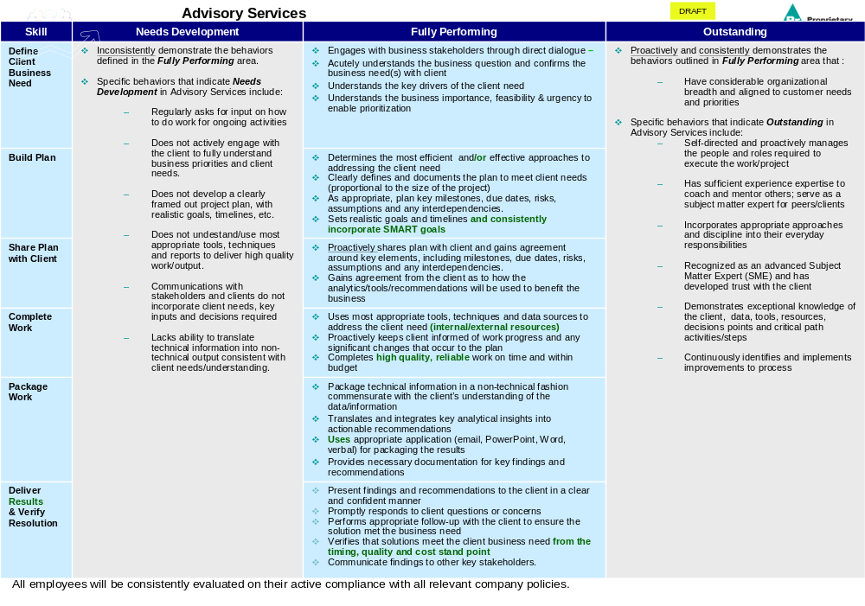
“Competencies” Better Understood
“Advisory Services” is an Example of a Competency.
Identifies the SKILLS required under the specific Competency
Middle section outlines the key BEHAVIORS under each Skill.

